Slide 1
mid-term design process
Mary zheng

Slide 2
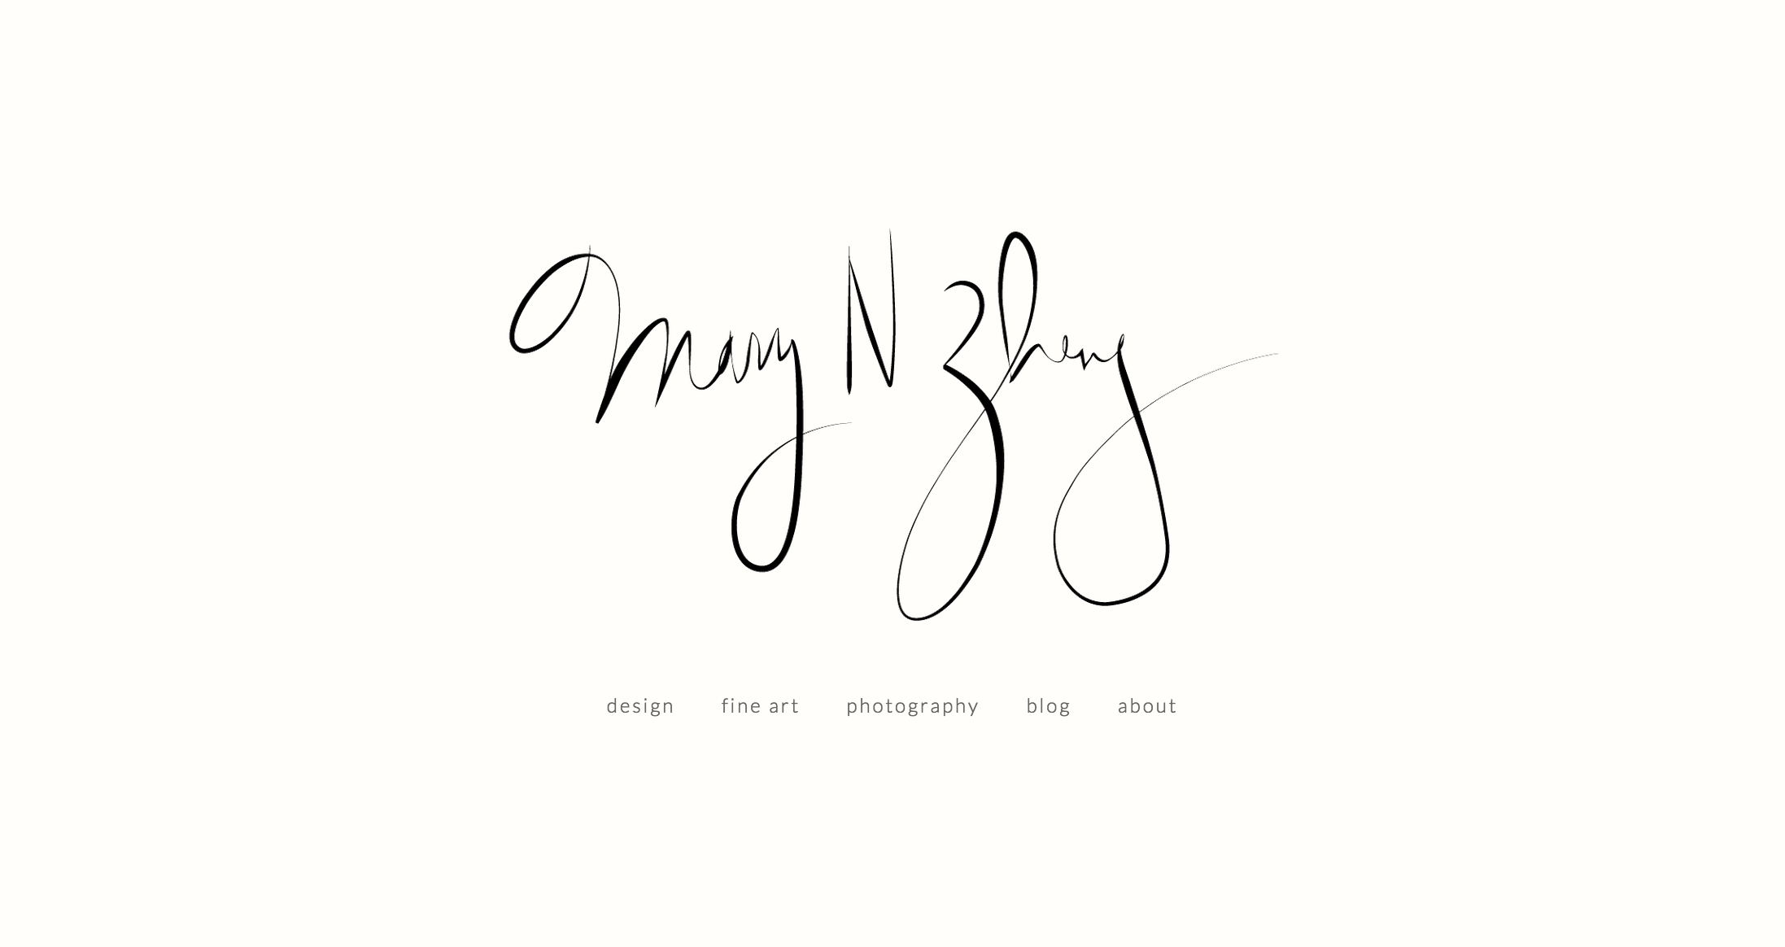
WHAT: DESIGN A PORTFOLIO WEBSITE
http://marynzheng.github.io/unit06/index.html
http://marynzheng.github.io/unit06/about.html

Slide 3
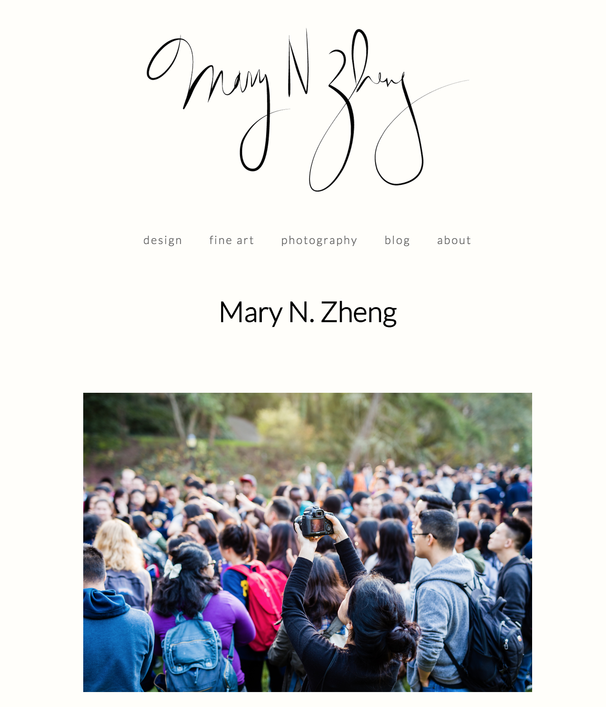

WHAT: DESIGN A PORTFOLIO WEBSITE
http://marynzheng.github.io/unit06/index.html
http://marynzheng.github.io/unit06/about.html

Slide 4
Audience/tone

Slide 5
AUDIENCE/TONE
Audience: potential employers
Tone: professional but informal
Explanation:
I’m working on a personal website, a mix of portfolio and blog. As of now I have no plans of trying to attract independent work, so it will mostly be a place where friends and family can come to check in on what I’ve been doing creatively, a showcase of best work.

Slide 6
inspiration

Slide 7
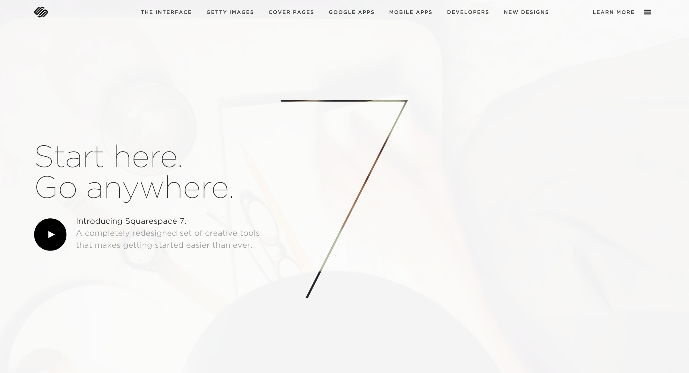
WEBSITES I WAS INSPIRED BY
http://squarespace.com/seven/

Slide 8
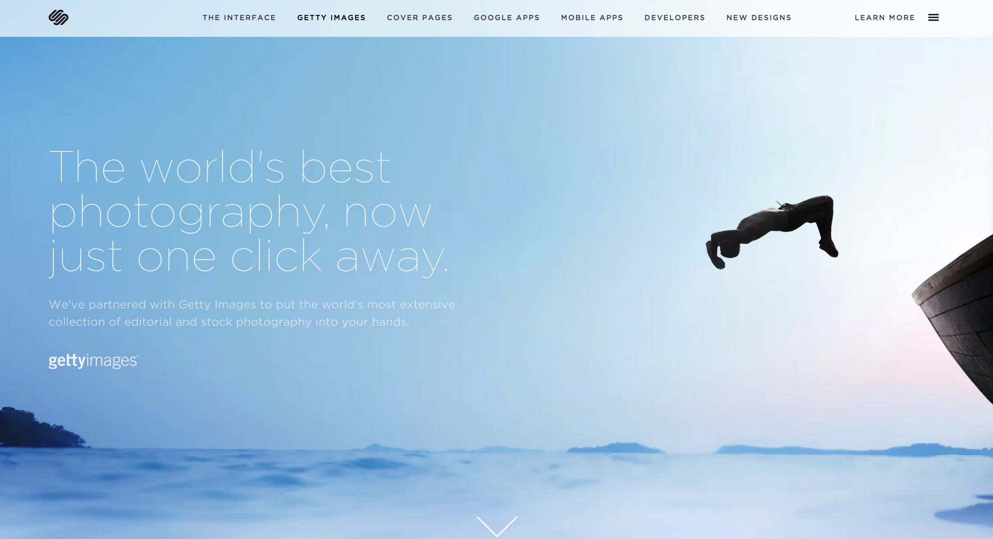
WEBSITES I WAS INSPIRED BY
http://squarespace.com/seven/

Slide 9
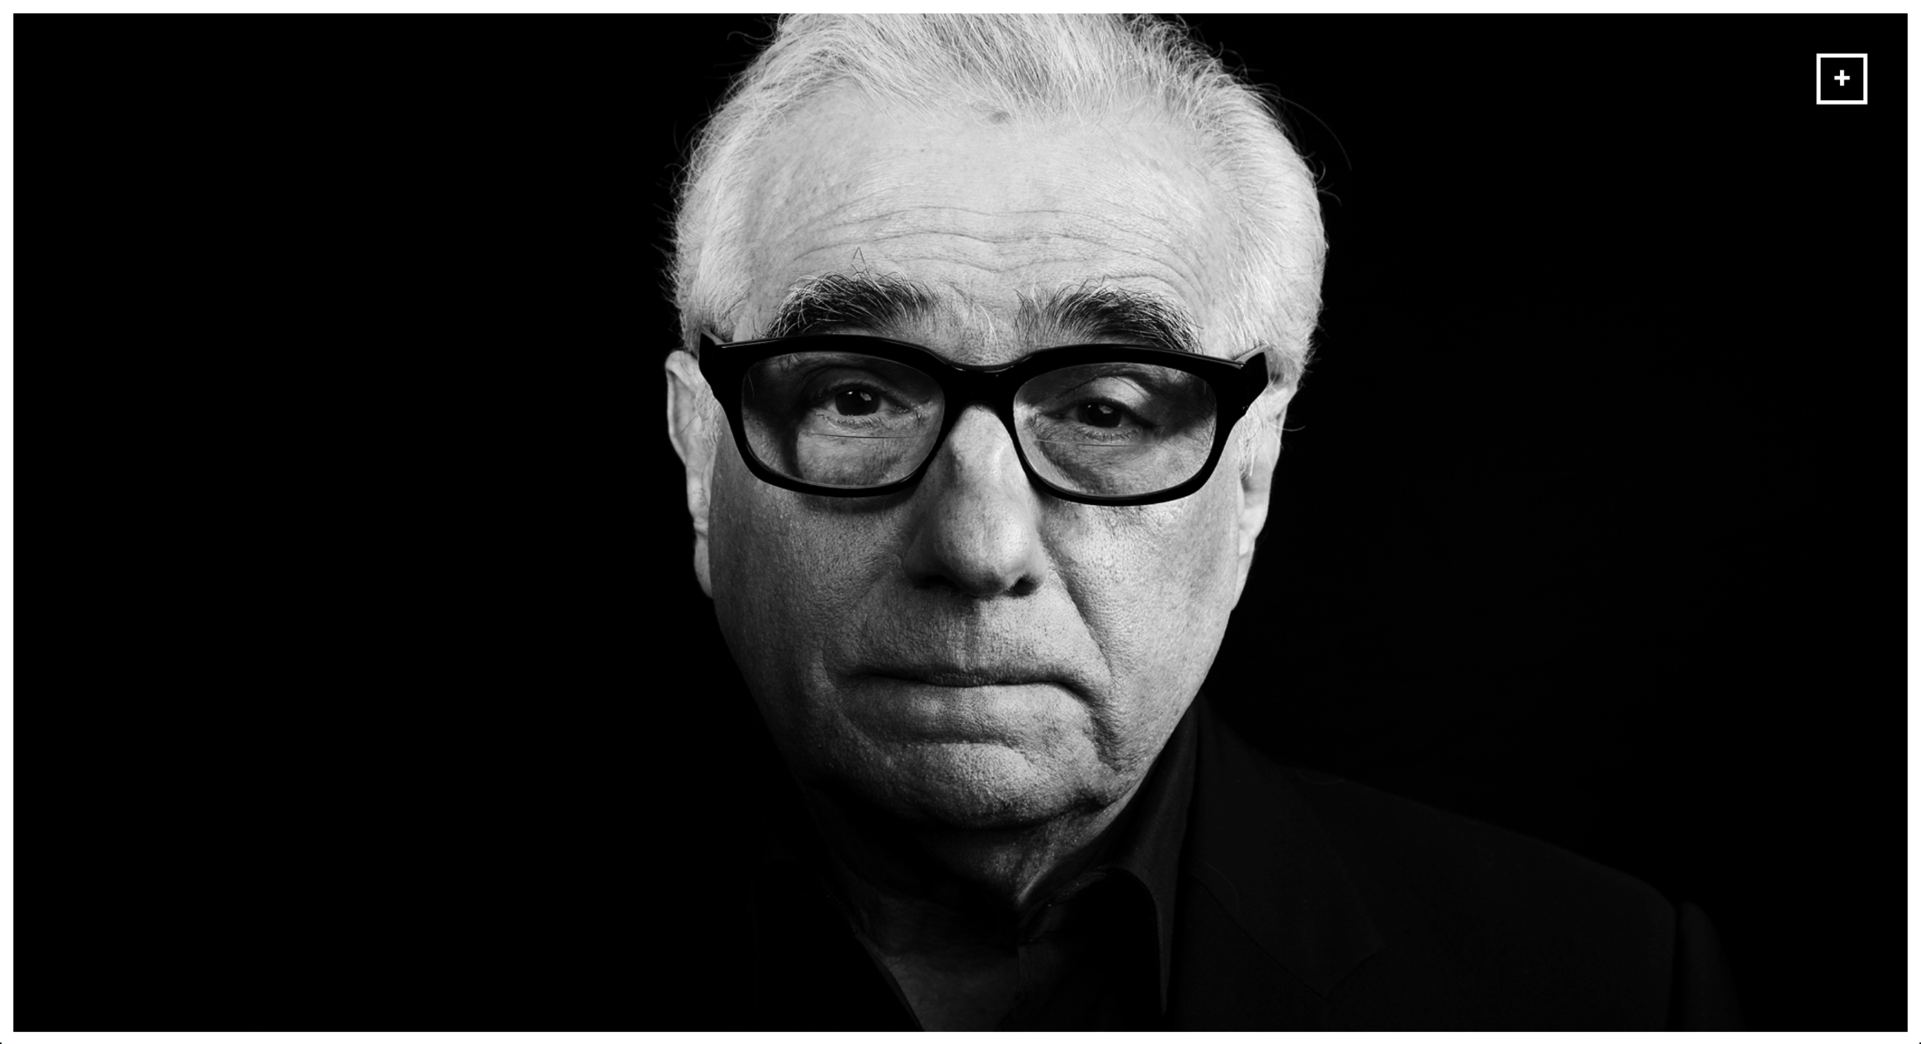
WEBSITES I WAS INSPIRED BY
http://cedricdiradourian.com/#

Slide 10
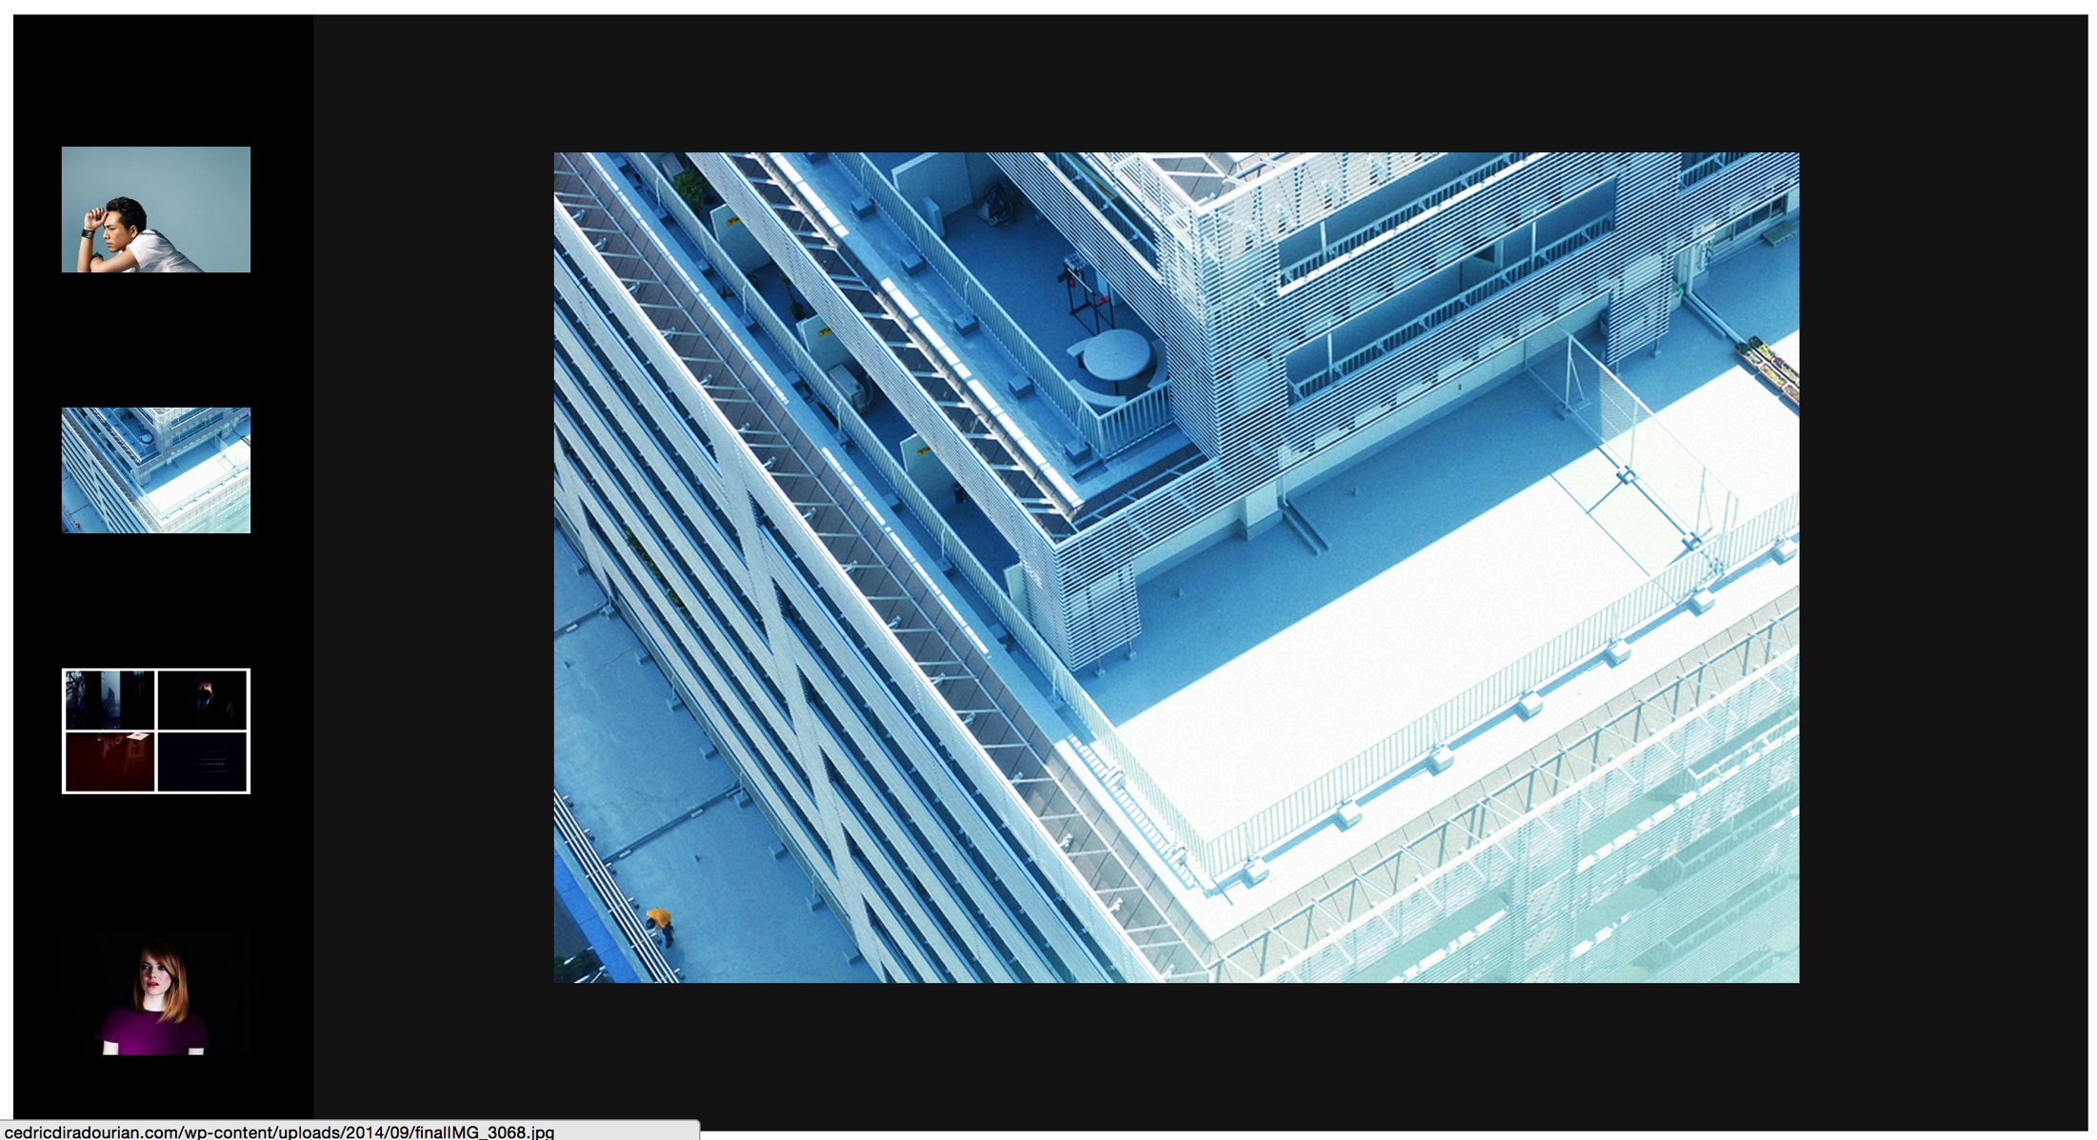
WEBSITES I WAS INSPIRED BY
http://cedricdiradourian.com/#

Slide 11
DESIGN PROCESS: THE GOOD

Slide 12
DESIGN: YAY
I wanted a simple website that could turn my name into a brand that I campaign under, so I am happy with how clean and straightforward my design was able to turn out. It’s very simple but serves my purposes!

Slide 13
DESIGN PROCESS: THE STRUGGLES

Slide 14
DESIGN: BOO
As a photographer, I generally like using full-size background images for my portfolio website and believe that is one of the few ways I can pique interest, so it was difficult compromising that with the simple, no-background layout.
Ultimately, I decided to sacrifice this on the homepage and plan to feature fewer, but better photos that will expand to full-size when clicked on (not yet shown).

Slide 15
DEVELOPMENT: THE STRUGGLES

Slide 16
DESIGN: BOO
Deciding on a width that was wide enough to complement an image-heavy layout, but not too wide as to keep the website experience very clean
Finding a balance in header font weights and the nav bar font, which will appear on every page
Coding in an efficient way, not cheating by centering things in HTML (as is my desire when things are going wrong, heh)

Slide 17
DEVELOPMENT: THE SOLUTIONS

Slide 18
DESIGN: YAY
Deciding on a width that was wide enough to complement an image-heavy layout, but not too wide as to keep the website experience very clean
Experimented with several sizes, and ultimately decided on a top margin of 100px to give some visual space, and an overall base width of around 680px to make body text readable but not too wide.
Finding a balance in header font weights and the nav bar font, which will appear on every page
Didn’t want to use serif fonts to create contrast, so decided to go with a thin, slightly textually spaced out font for the nav bar, and make the rest of the headers and body copy bigger/bolder/a darker color.
Coding in an efficient way, not cheating by centering things in HTML (as is my desire when things are going wrong, heh)
Persevered and figured out what I was doing wrong in the end! Splitting the code into different sections and being more specific with my CSS helped.

Slide 19
WHAT I LEARNED

Slide 20
LESSONS LEARNED
Don’t give up! It’s easy to use shortcuts (<center> in HTML, mainly), but so much more cleaner and rewarding to keep iterating and scanning/rescanning through my code to figure out and correct what is actually wrong.
The more specific my vision beforehand, the easier it is to create. Before, I never saw the use of having a detailed wireframe, but it makes sense now. It’s so much better to hash things out on paper/Photoshop than to keep all my ideas in my head! (I have a similar portfolio website created on Squarespace already, so I used that as a visual model to help me think about what I would like this one to look like.)
But, I know that I’m far from done, and still have a lot to learn- so any critique is appreciated! Thank you for your time! ☺

